Slide 1
Maintainability Design II - Part 4 (Behavioral Design Patterns)
CS 301: IT Solution Architecture
Week 6

Slide 2
Motivation
Problem: Imagine you have a popular class that when the state of the object changes, many other classes want to know! These classes can keep checking the popular class but it will be waste of effort.

Slide 3
Observer

Slide 4
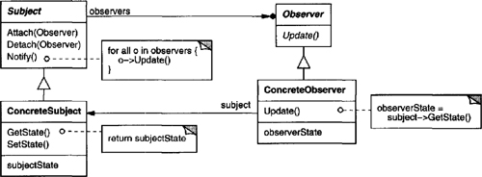
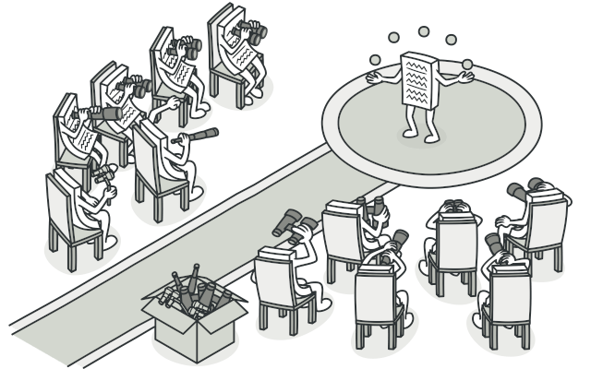
Pattern: Observer
Intent
Define a one-to-many dependency between objects so that when one object changes state, all its dependents are notified and updated automatically.
Notes:
https://refactoring.guru/design-patterns/observer
Example: To maintain a synchronized clock timer for a set of interested objects. Observer and Observable in Java
Use the Observer pattern when:
When an abstraction has two aspects, one dependent on the other. Encapsulating these aspects in separate objects lets you vary and reuse them independently.
When a change to one object requires changing others, and you don’t know how many objects need to be changed.
When an object should be able to notify other objects without making assumptions about who these objects are. In other words, you don’t want these objects tightly coupled.

Slide 5
Let’s assume a claims system
The claims application is meant for staff to login and submit a expense claim.
The expense claims form comprises of the staff personal details and claim items details.
The staff details are stored in centralized MSSQL DB while the claims details are stored in a MySQL DB used only by the claims application.
The expense claim request once submitted, is sent to the appropriate manager/head for approval.
For approved claims, a daily scheduler is configured to invoke the application to send these approved claims to SAP system.
On a monthly basis, staff with managerial role is able to generate claims reports of their staff.

Slide 6
Scenario - Observer
Scenario : The lookup values in the DB are updated throughout the day by other sources. In this case, the data in the singleton implemented earlier can become obsolete. There is a need to email admin when the lookup values are updated and other objects in the future which require the notification of the updates.
public class Cache {
Map<String, String> lookupValues = new HashMap<String, String>();
private Cache() {
//read from DB and put into map
lookupValues.put("TR","Transport");
}
private static final Cache
INSTANCE = new Cache();
public static Cache getCache() {
return Cache.INSTANCE;
}
public String lookupValue(String name) {
return lookupValues.get(name);
}
}

Slide 7
Observer Implementation
“.one-to-many dependency between objects.”
Create an interface of the subject with methods to register, notify and unregister.
Create concrete (subject) class implementing the subject interface.
Create interface with methods for the observer
Update concrete (observer) to implement the interface.
Register observers to the subject

Slide 8
Observer Implementation
public interface LVSubjectInterface {
void register(LVObserverInterface anObserver);
void unregister(LVObserverInterface anObserver);
void notifyRegisteredUsers();
}
public class LVSubject implements LVSubjectInterface{
private LVSubject() {}
private static LVSubject subject = new LVSubject();
public static LVSubjectInterface getSubject()
{ return subject; }
List<LVObserverInterface> observerList =
new ArrayList<LVObserverInterface>();
public void register(LVObserverInterface anObserver){
observerList.add(anObserver);
}
public void unregister(LVObserverInterface
anObserver) { observerList.remove(anObserver); }
public void notifyRegisteredUsers() {
for (LVObserverInterface observer: observerList)
observer.updateValue();
}
}
interface LVObserverInterface {
public void updateValue();
}
public class Cache implements LVObserverInterface {
private Cache() {
LVSubject.getSubject().register(this);
}
public void updateValue() { / some processing }
}
public class EmailObserver implements LVObserverInterface {
public EmailObserver() {
LVSubject.getSubject().register(this);
}
public void updateValue() { / some processing }
}
1
3
4
2
5
4
5
public class IncomingJob {
public static void main(String[] args) {
LVSubject.getSubject().notifyRegisteredUsers();
}
}
Notes:
Did we just use another pattern here? If so, which one is it?

Slide 9
Motivation
Problem: Imagine you are tasked to perform a series of checks sequentially before returning the result. These checks depend on the input value and can varies (some checks are required, some not). Writing these checks in a conditional manner create a set of messy codes to maintain.

Slide 10
Chain of Responsibility

Slide 11

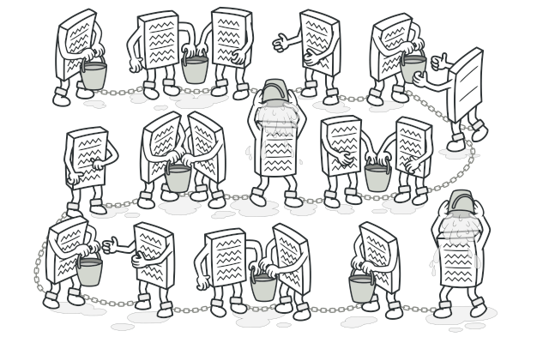
Pattern: Chain of Responsibility
Intent
Avoid coupling the sender of a request to its receiver by giving more than one object a chance to handle the request. Chain the receiving objects and pass the request along the chain until an object handles it.
Notes:
Use Chain of Responsibility when
more than one object may handle a request, and the handler isn’t known a priori. The handler should be ascertained automatically.
you want to issue a request to one of several objects without specifying the receiver explicitly.
the set of objects that can handle a request should be specified dynamically.

Slide 12
Let’s assume a claims system
The claims application is meant for staff to login and submit a expense claim.
The expense claims form comprises of the staff personal details and claim items details.
The staff details are stored in centralized MSSQL DB while the claims details are stored in a MySQL DB used only by the claims application.
The expense claim request once submitted, is sent to the appropriate manager/head for approval.
For approved claims, a daily scheduler is configured to invoke the application to send these approved claims to SAP system.
On a monthly basis, staff with managerial role is able to generate claims reports of their staff.

Slide 13
Scenario – Chain of Responsibility
Scenario : The approver required depend on the claims amount. E.g. for <$1000, reporting manager can approve it. For <$5000, department head is required to approve it. For >=$5000, company head is required to approve it.
public class ClaimsForm {
public void submitClaim(int amount) {
if (amount < 1000 ) {
ApproverReportingManager reportingManager = new ApproverReportingManager();
reportingManager.handleMessage(amount);
} else if (amount < 5000 ) {
ApproverDeptHead deptHead = new ApproverDeptHead();
deptHead.handleMessage(amount);
} else {
ApproverCompanyHead coHead = new ApproverCompanyHead();
coHead.handleMessage(amount);
}
}
}

Slide 14
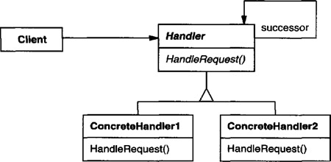
COR Implementation
“. . Chain the receiving objects and pass the request along the chain… “
Create an interface of the handler
Create concrete (approver) class implementing the handler interface.
Chain up the handlers (approvers).

Slide 15
COR Implementation
public interface Approver {
void handleMessage(int amount);
void nextApprover(Approver nextApprover);
Approver getNextApprover();
}
public class ApproverReportingManager implements Approver {
private Approver nextApprover;
private int limit = 1000;
public void handleMessage(int amount) {
if (amount < limit ) {
System.out.println("Reporing Manager is handling it");
} else {
nextApprover.handleMessage(amount);
}
}
public void nextApprover(Approver nextApprover) {
this.nextApprover = nextApprover;
}
public Approver getNextApprover() {
return nextApprover;
}
} * ApproverDeptHead and ApproverCompanyHead are constructed similarly
1
public class ClaimsForm {
private Approver firstApprover;
public ClaimsForm() {
firstApprover = new ApproverReportingManager();
firstApprover.nextApprover(
new ApproverDeptHead());
firstApprover.getNextApprover().nextApprover(
new ApproverCompanyHead());
}
public void submitClaim(int amount) {
firstApprover.handleMessage(amount);
}
public static void main(String[] args) {
ClaimsForm form = new ClaimsForm();
form.submitClaim(999);
form.submitClaim(4999);
form.submitClaim(10000);
}
}
3
2
Can this design be improved?
Notes:
Think along the line of
- Other patterns

Slide 16
Exercise
Behavioral Design Patterns

Slide 17
Gang of Four (GoF) patterns
Creational Patterns (abstracting the object-instantiation process)
Factory Method Abstract Factory Singleton
Builder Prototype
Structural Patterns (how objects/classes can be combined to form larger structures)
Adapter Bridge Composite
Decorator Facade Flyweight
Proxy
Behavioral Patterns (communication between objects)
Command Interpreter Iterator
Mediator Observer State
Strategy Chain of Responsibility Visitor
Template Method

Slide 18
Design Patterns by GoF Uses of Creational Patterns (Summary)
Singleton
To ensure only one instance of class and provide global point of access to it
Builder
To separate construction of a complex object from its representation
Factory Method
To define an interface for creating an object
But let the subclass decide which class to instantiate

Slide 19
Design Patterns by GoF Uses of Structural Patterns (Summary)
Adapter
Convert class interface into another interface to be used by clients with incompatible interfaces
Facade
To provide a unified interface to a set of interfaces in a subsystem

Slide 20
Design Patterns by GoF Uses of Behavioral Patterns (Summary)
Chain of Responsibility
Avoid coupling the sender of a request to its receiver by giving more than one object a chance to handle the request. Chain the receiving objects and pass the request along the chain until an object handles it.
Observer
To notify observers when the subject state changes

Slide 21
References
SOLID Principles: Explanation and examples - https://itnext.io/solid-principles-explanation-and-examples-715b975dcad4
Examples and definitions of the SOLID principles in Software Design - https://blog.scottlogic.com/2018/06/26/solid-principles.html
The 5 S.O.L.I.D. Principles Explained - https://dzone.com/articles/the-5-solid-principles-explained
Design Patterns: Elements of Reusable Object-Oriented Software by John Vlissides; Ralph Johnson; Richard Helm; Erich Gamma
https://refactoring.guru/
Java Design Patterns: A Hands-On Experience with Real-World Examples by Vaskaran Sarcar
Design Patterns and Best Practices in Java by Lucian-Paul Torje; Kamalmeet Singh; Adrian Ianculescu
Head First Design Patterns by Elisabeth Robson; Eric Freeman; Kathy Sierra; Bert Bates
Design Patterns reference by SourceMaking
Vince Huston's Design Patterns page (includes code examples in C++ and Java)
OODesign.com
https://www.tutorialspoint.com/design_pattern/index.htm
Notes:
other singletons: consider SoundPlayer object

